Slide 1
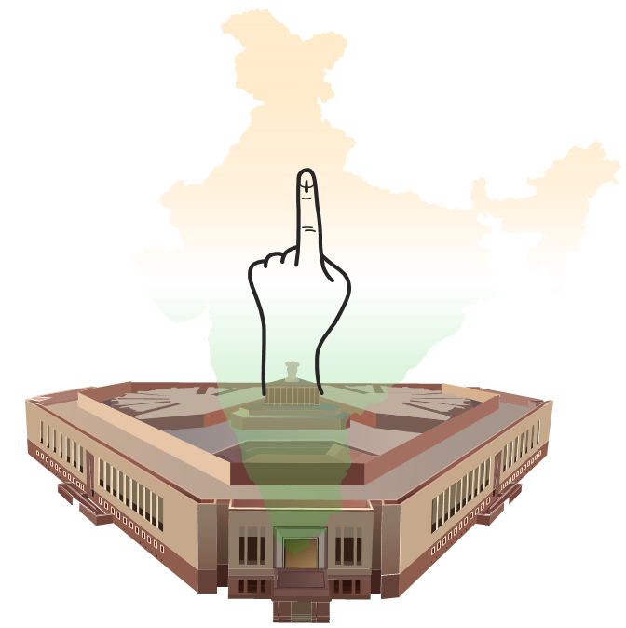

INDIA GENERAL ELECTION RESULT ANALYSIS 2024
by Snehal Ahirrao

Slide 2

Introduction
The 2024 General Elections in India are an important event in the country’s democracy, showing how politics and public opinion are changing. This project focuses on analyzing the election results using SQL queries and data analysis. By using SQL for data analysis, this project aims to give a clear picture of the 2024 elections, helping us understand the political landscape and voter behavior better.

Slide 3
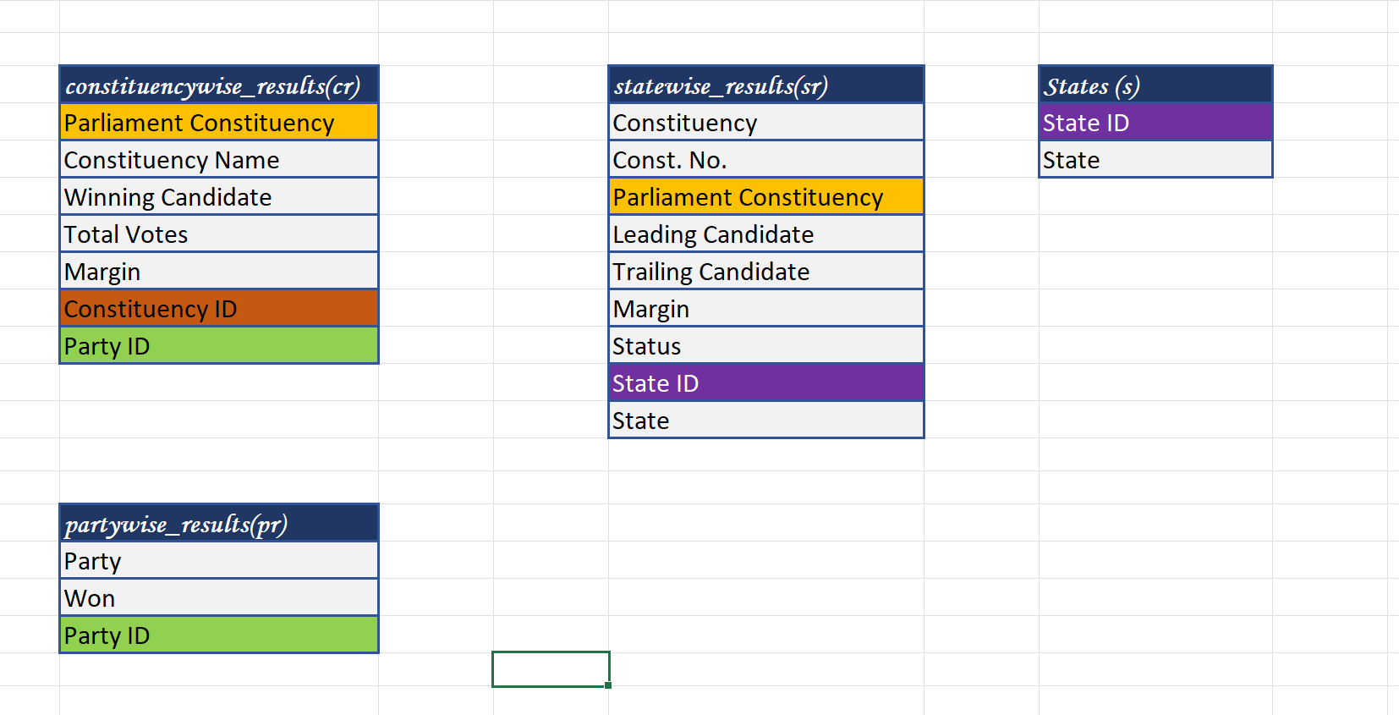
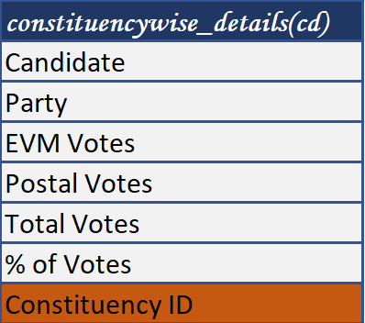
ENTITY RELATIONSHIP DIAGRAM (ERD) / SCHEMA
Party ID
State ID
Parliament
Constituency
Constituency ID

Slide 4
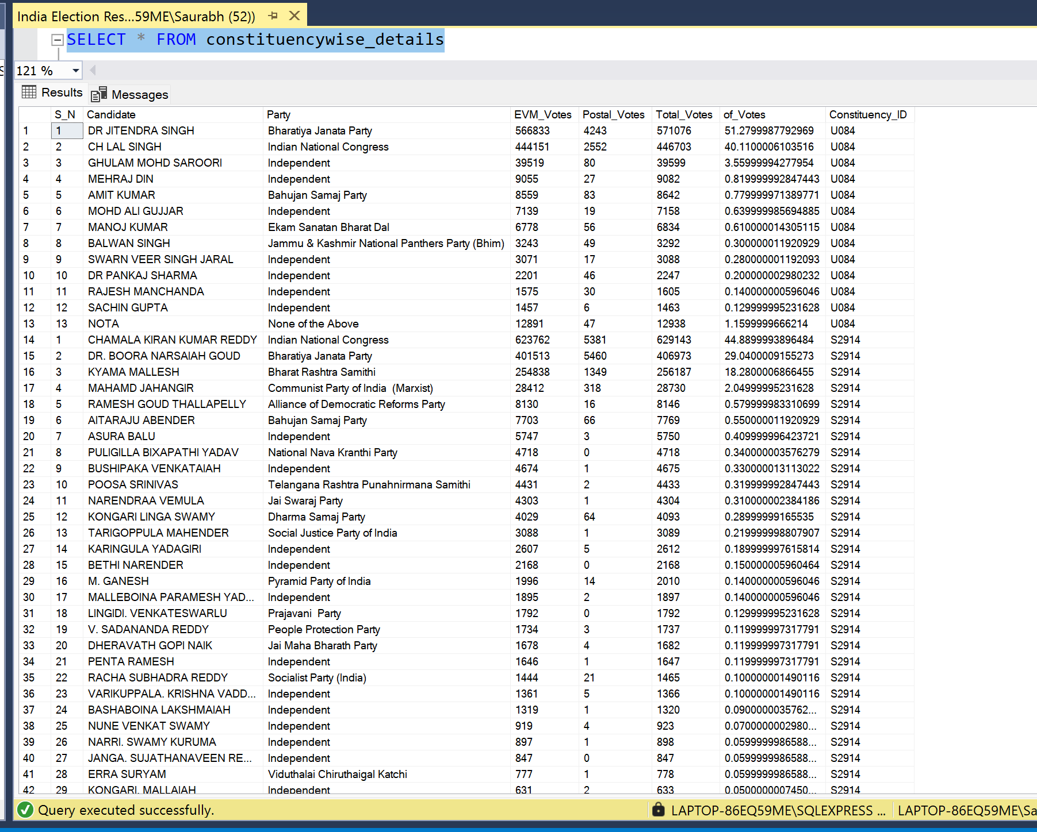
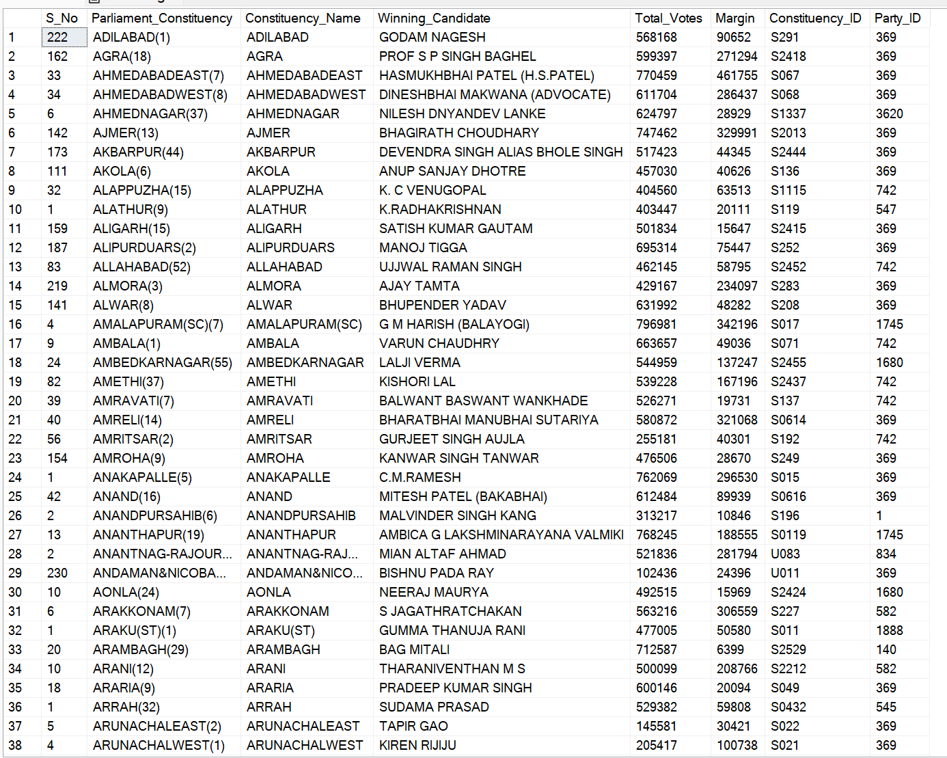
Datasets
Table 1 : constituencywise_details
Table 2: constituencywise_results

Slide 5
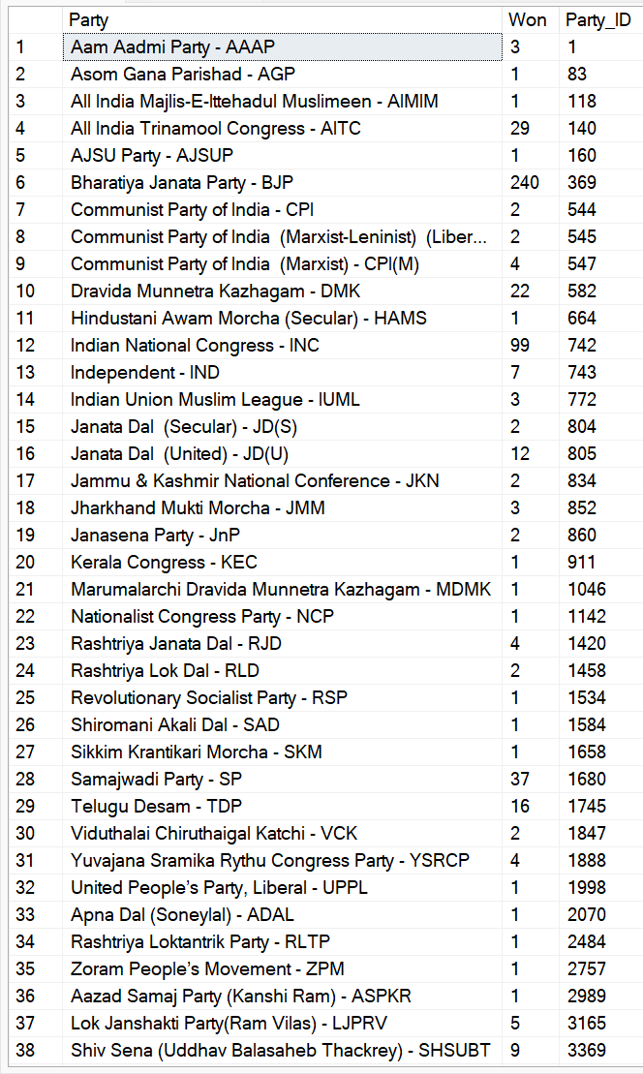
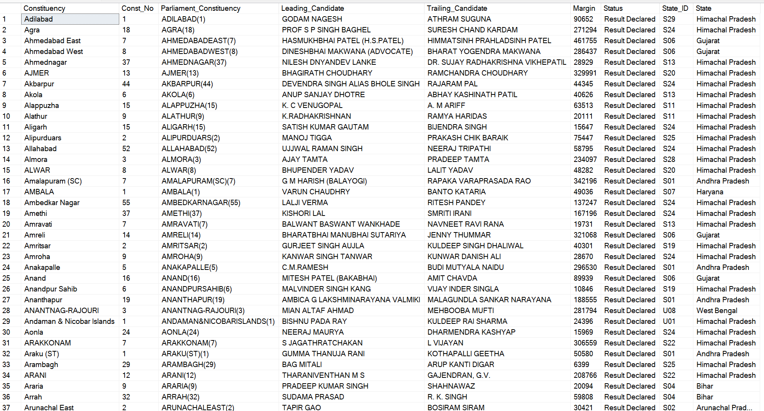
Table 3 : partywise_results
Table 4 : statewise_results

Slide 6
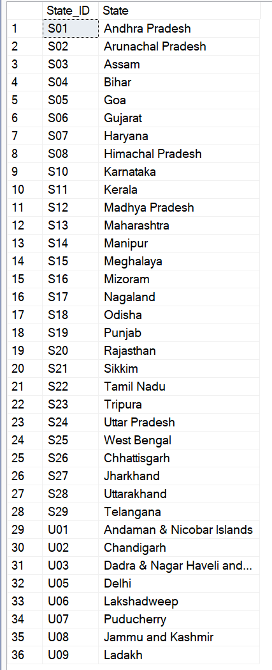
Table 5 : states

Slide 7
Problem Statement
1.Total Number of Seats in 2024 Elections.
2.What are the total number of seats available for elections in each state?
3.Total Seats Won by NDA Alliance.
4.Seats Won by NDA Alliance Parties.
5.Total Seats Won by I.N.D.I.A. Alliance - Indian National Developmental Inclusive Alliance (I.N.D.I.A)
6.Seats Won by I.N.D.I.A. Alliance Parties.
7.Add new column field in table partywise_results to get the party Allianz as NDA, I.N.D.I.A and OTHER.
8.Which party alliance (NDA, I.N.D.I.A, or OTHER) won the most seats across all states?
9.Winning candidates name,their party name, their alliance name, total votes,and the margin of victory for a specific state and constistuency?

Slide 8
Problem Statement
10.What is the distribution of EVM votes Versus Postal votes for candidates in a specific constituency?
11.Which Parties won the most seats in a State, and how many seats did each party win?
12.What is the total number of seats won by each party alliance (NDA, I.N.D.I.A, and OTHER) in each state for the India Elections 2024?
13.Which candidate received the highest number of EVM votes in each constituency (Top 10) ?
14.Which candidate won and which candidate was the runner-up in each constituency of state for the 2024 elections?
15.For the state of Maharashtra, what are the total number of seats, total number of candidates, total number of parties, total votes (including EVM and postal), and the breakdown of EVM and postal votes?

Slide 9
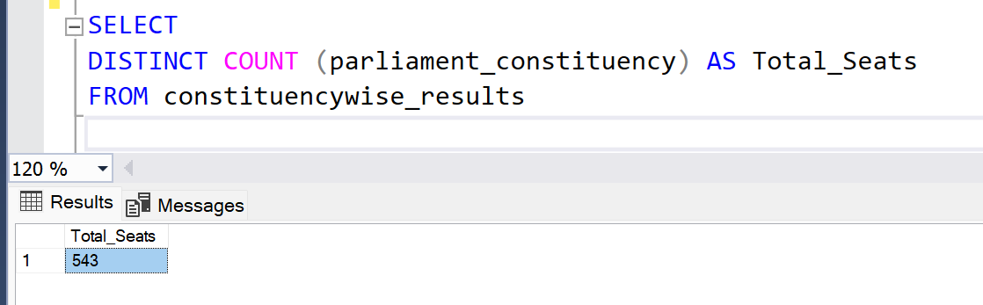
Case study Questions
1.Total Number of Seats in 2024 Elections.

Slide 10
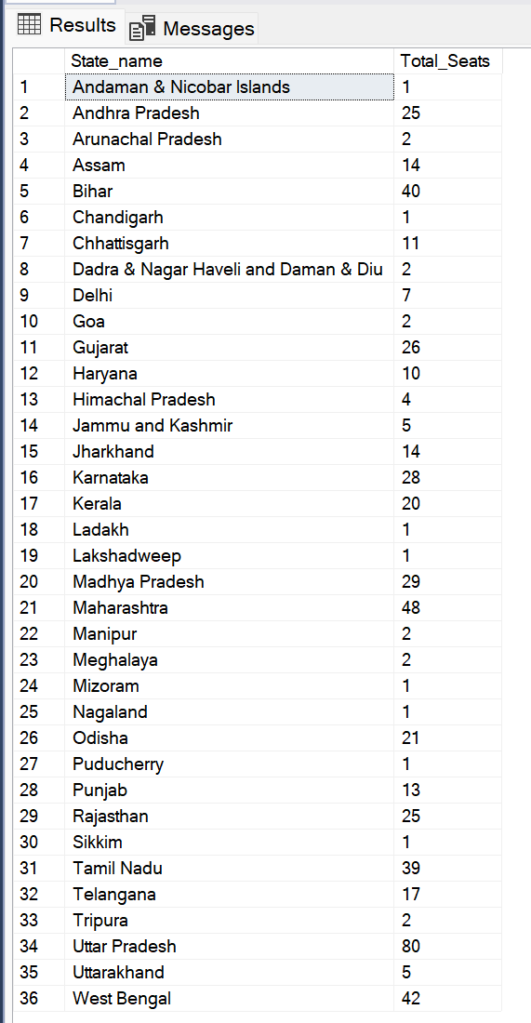
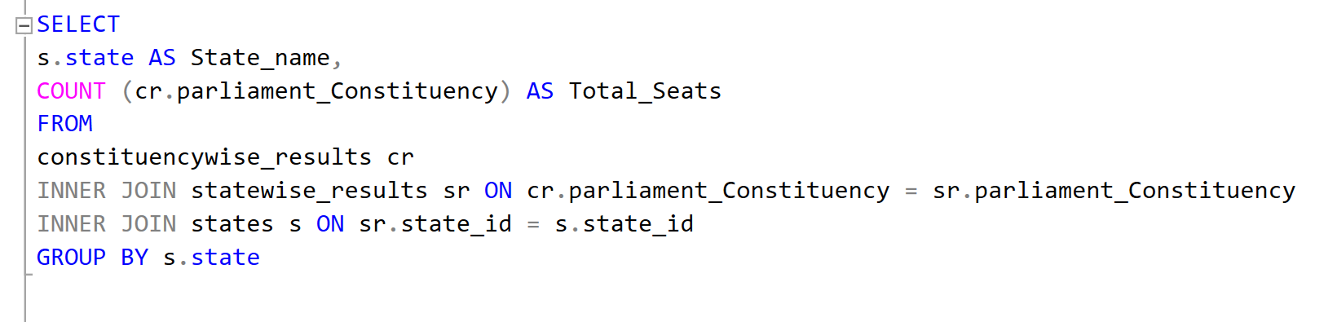
2.What are the total number of seats available for elections in each state?

Slide 11
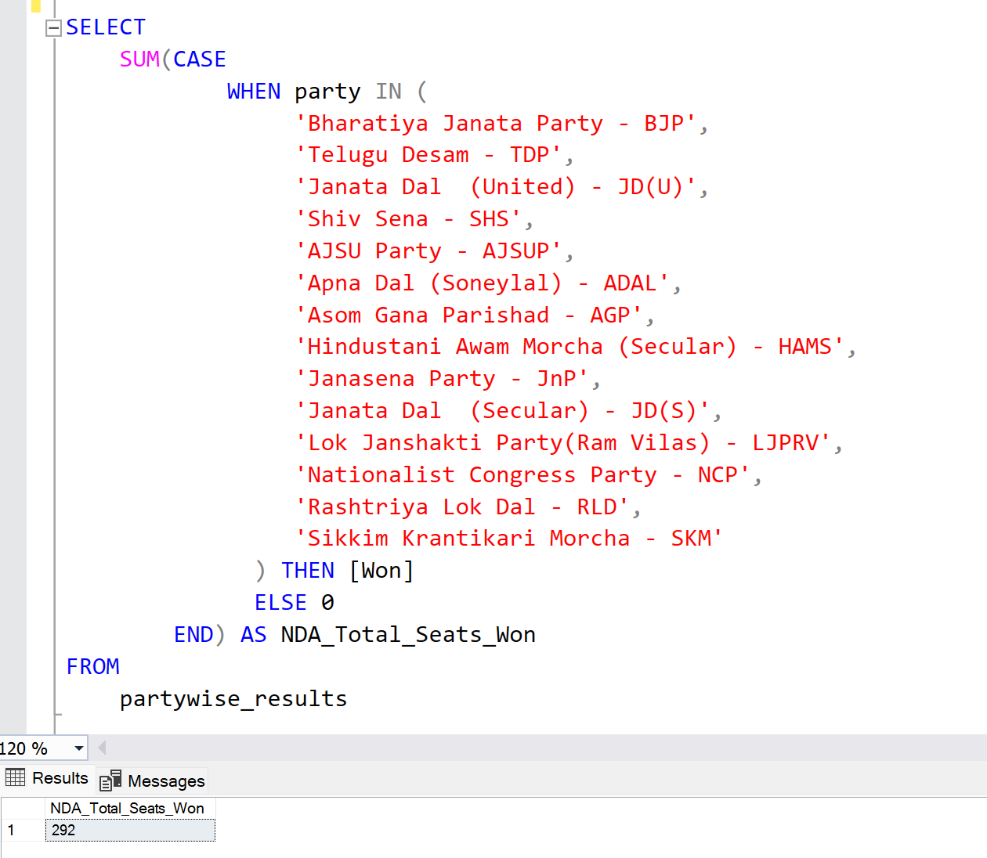
3.Total Seats Won by NDA Alliance.

Slide 12
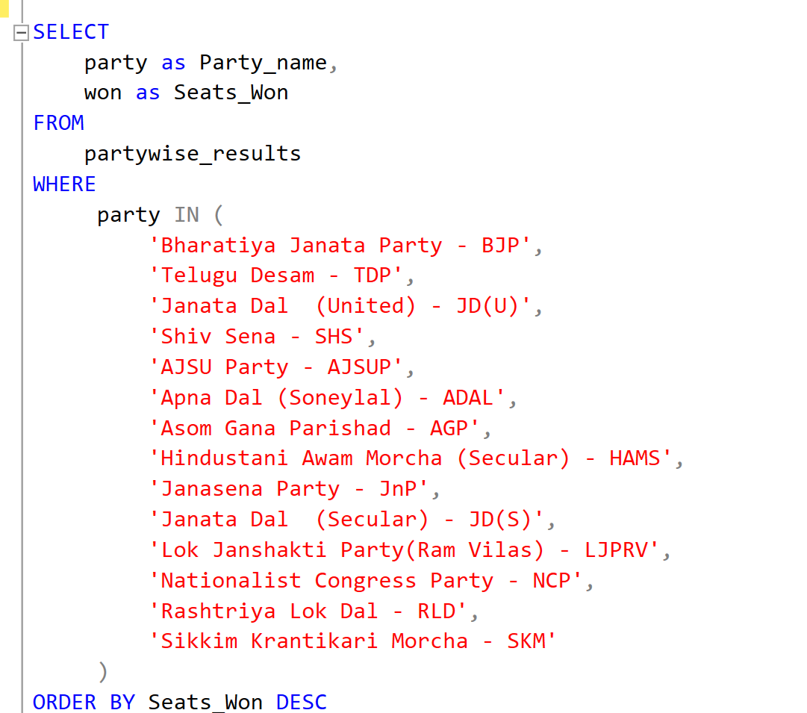
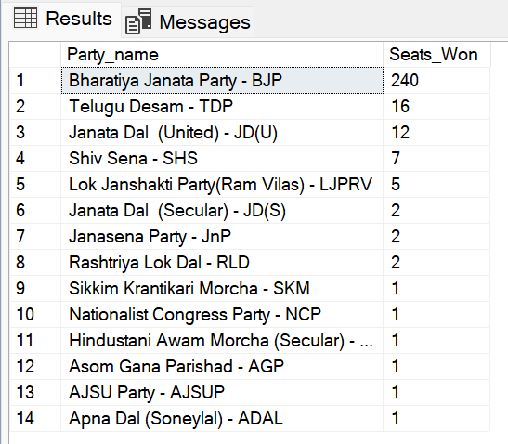
4.Seats Won by NDA Alliance Parties.

Slide 13
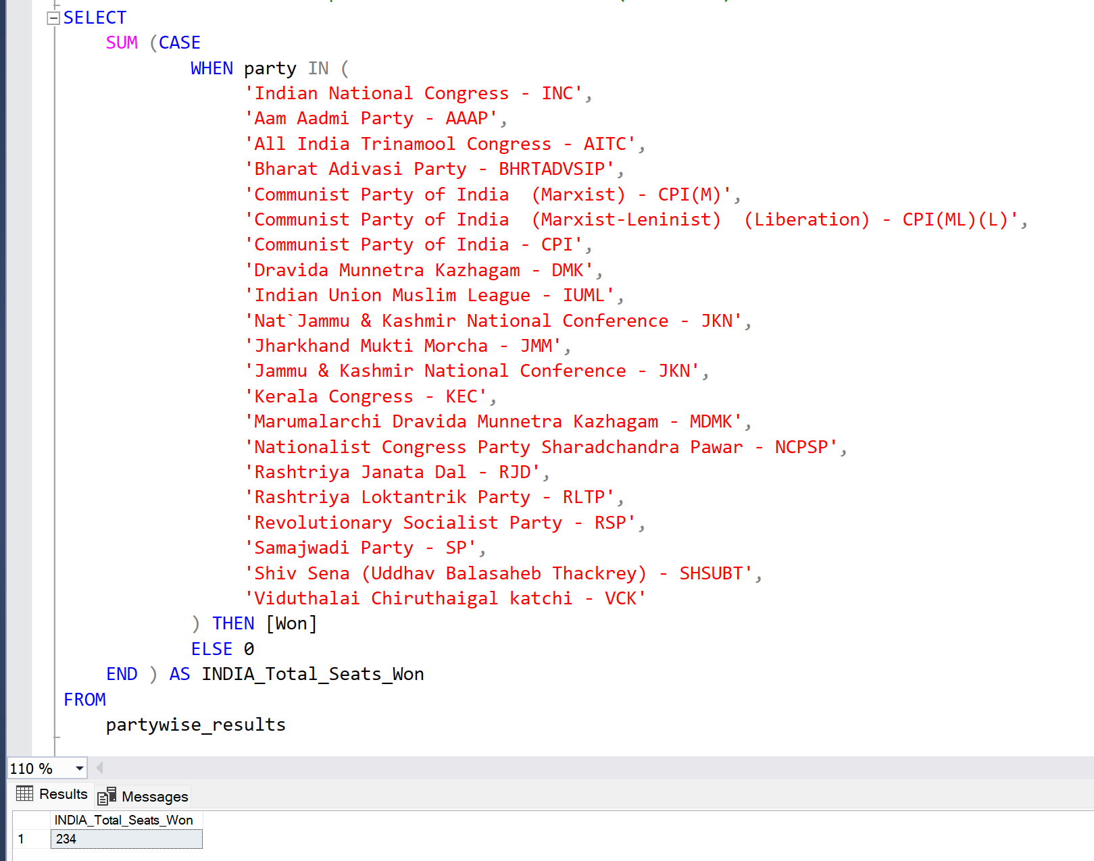
5.Total Seats Won by I.N.D.I.A. Alliance - Indian National Developmental Inclusive Alliance (I.N.D.I.A)

Slide 14
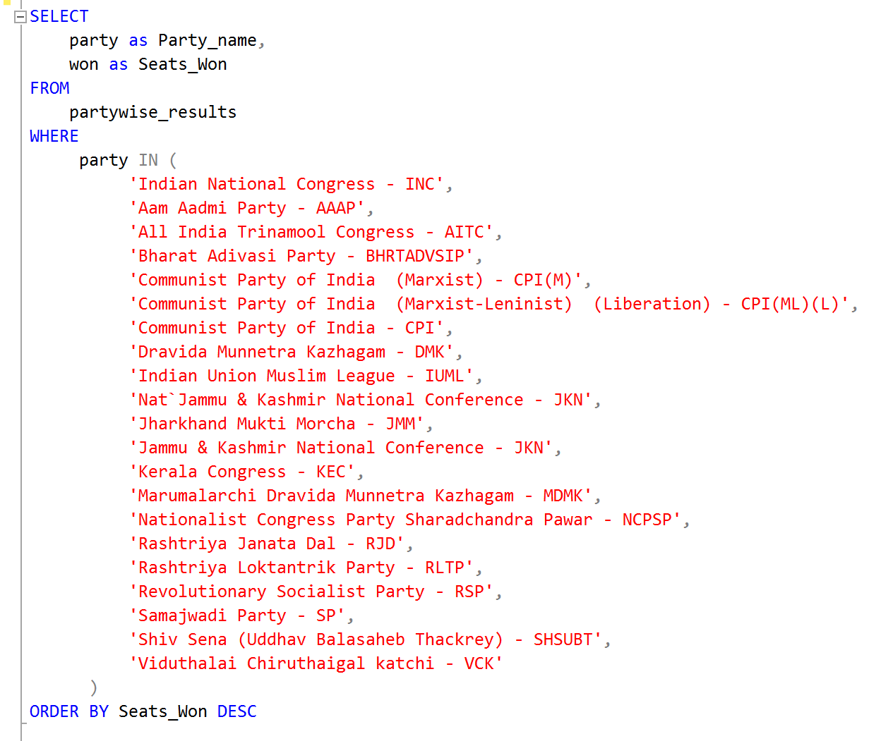
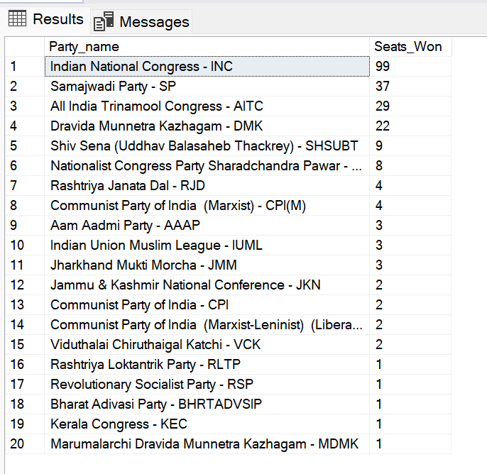
6.Seats Won by I.N.D.I.A. Alliance Parties.

Slide 15
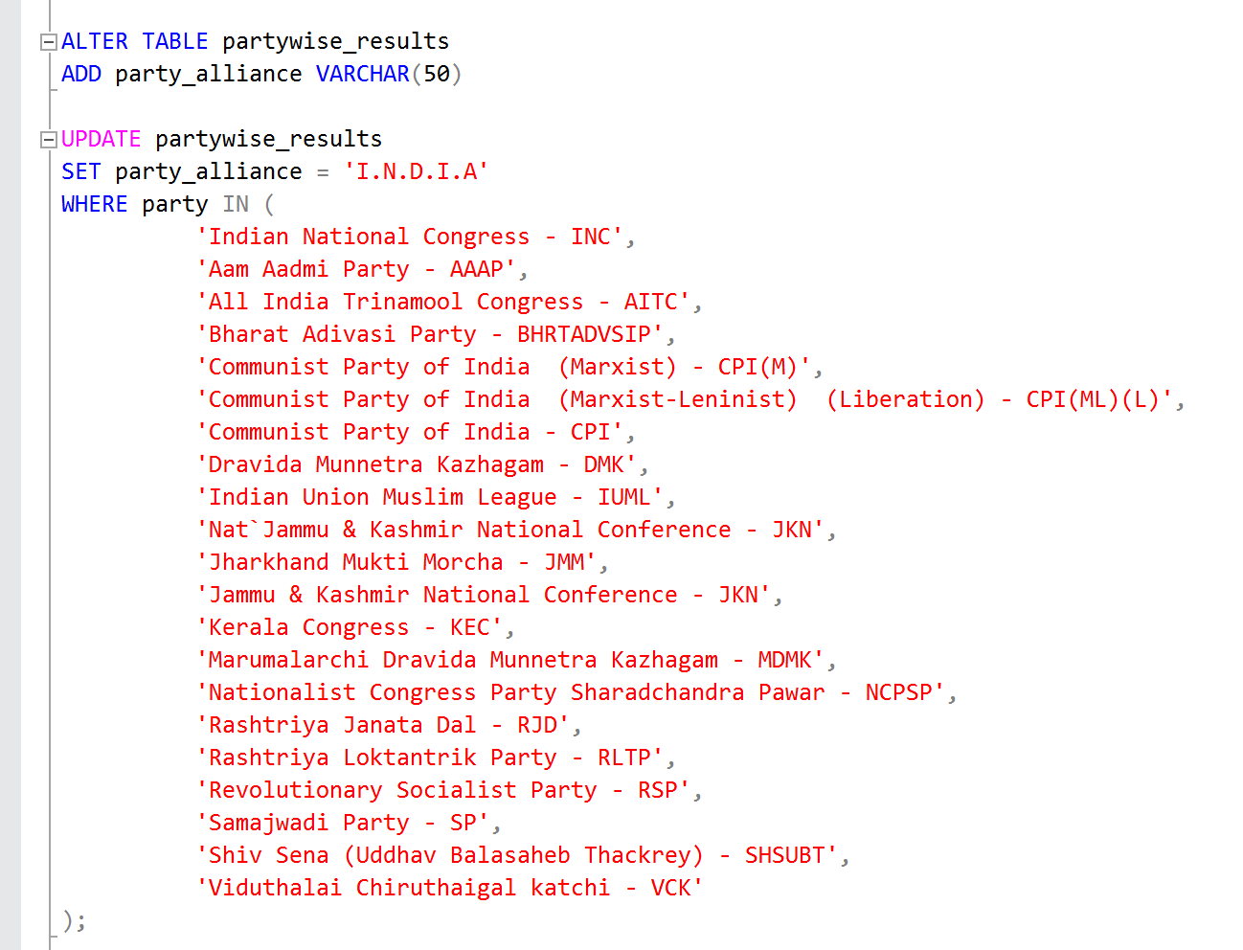
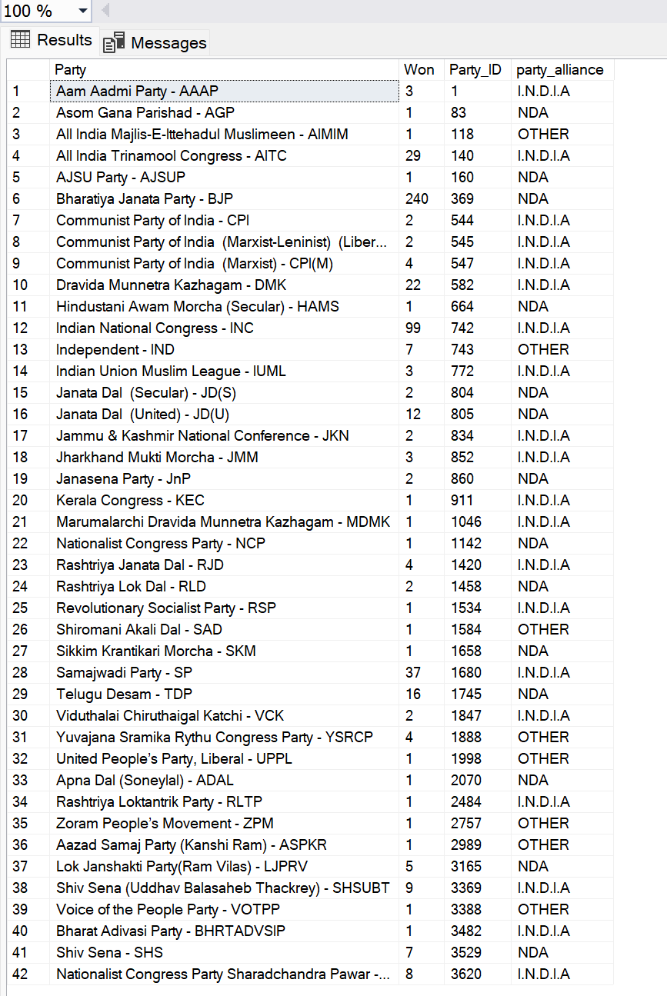
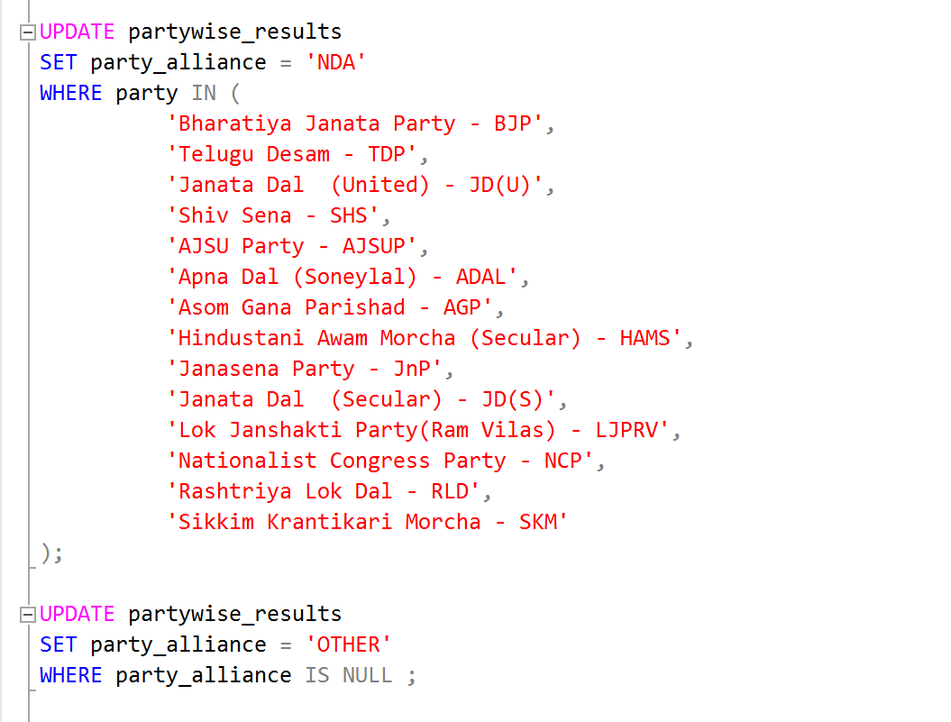
7.Add new column field in table partywise_results to get the party Allianz as NDA, I.N.D.I.A and OTHER.

Slide 16
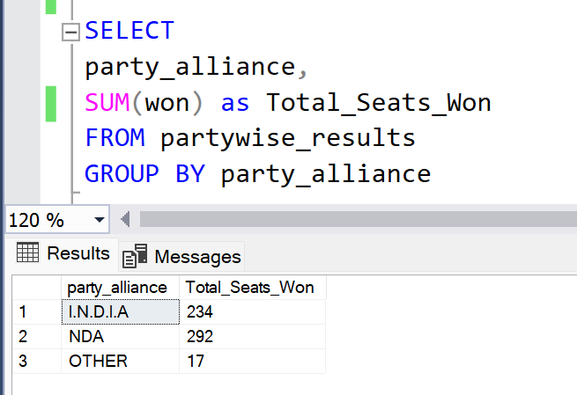
8.Which party alliance (NDA, I.N.D.I.A, or OTHER) won the most seats across all states?

Slide 17
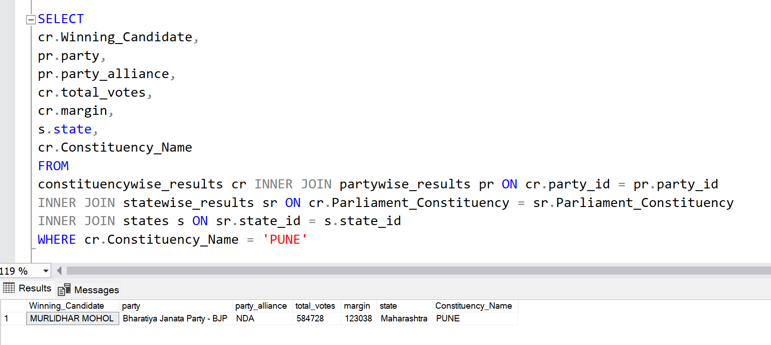
9.Winning candidates name,their party name, their alliance name, total votes,and the margin of victory for a specific state and constistuency?

Slide 18
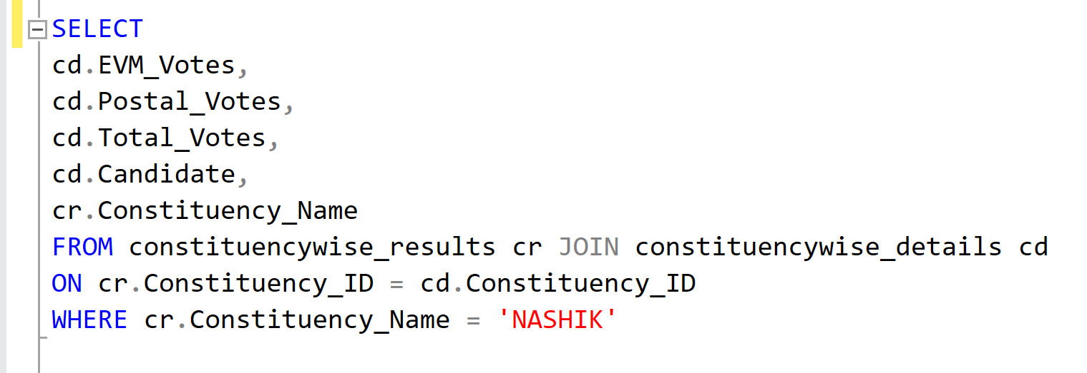
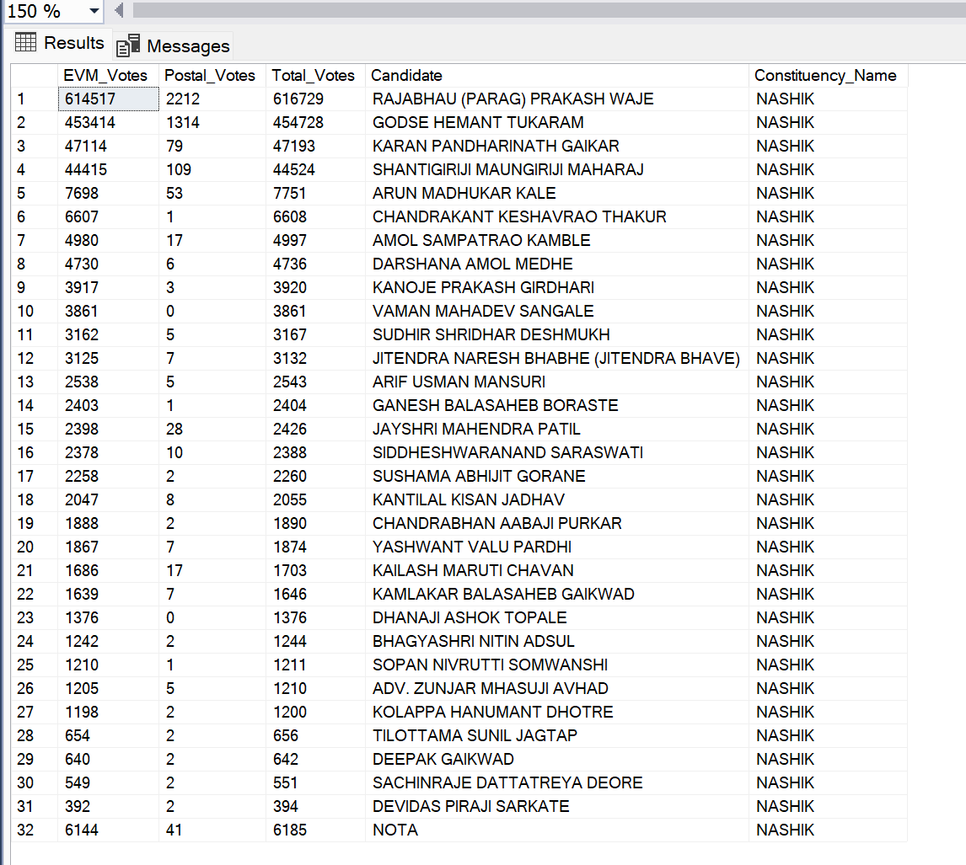
10.What is the distribution of EVM votes Versus Postal votes for candidates in a specific constituency?

Slide 19
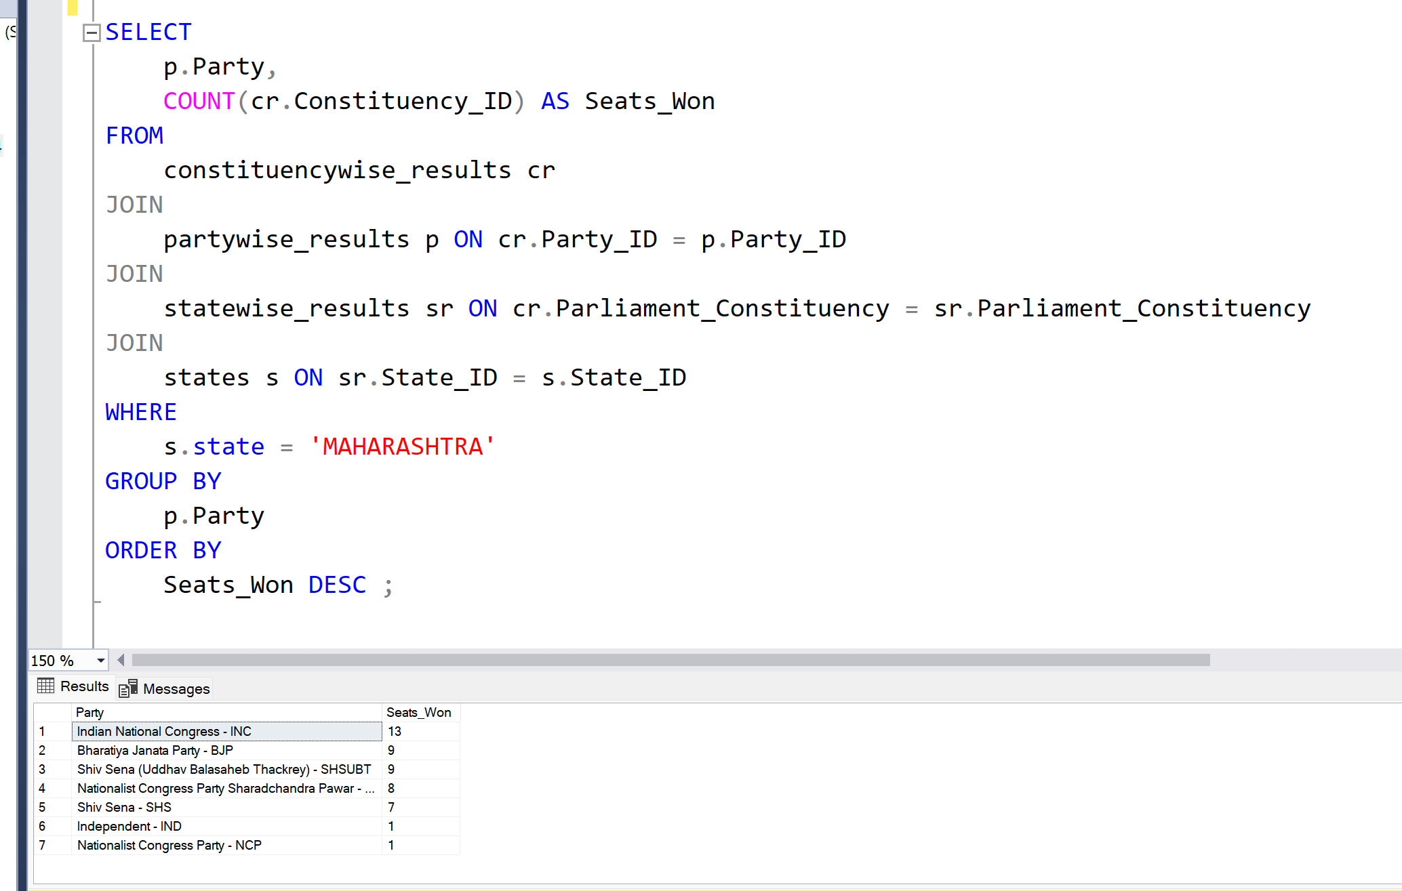
11.Which Parties won the most seats in a State, and how many seats did each party win?

Slide 20
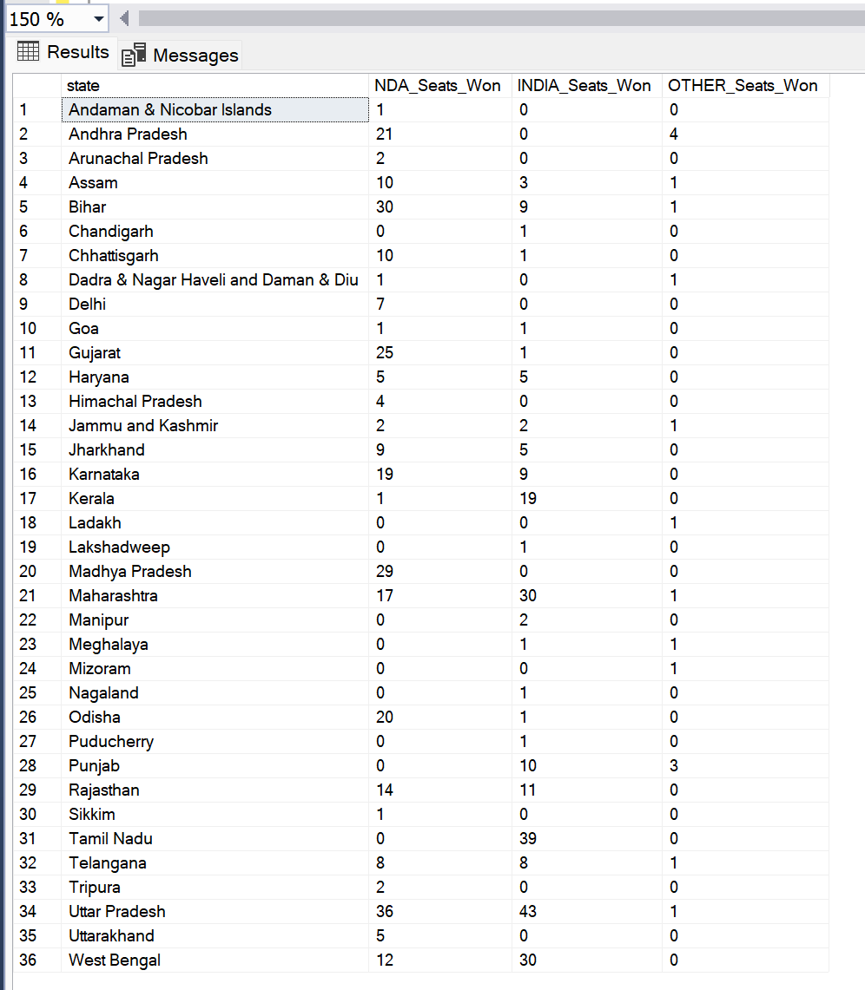
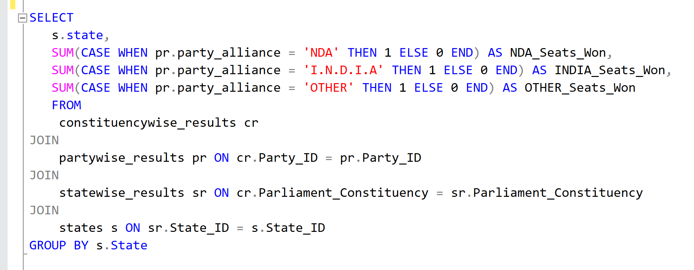
12.What is the total number of seats won by each party alliance (NDA, I.N.D.I.A, and OTHER) in each state for the India Elections 2024?

Slide 21
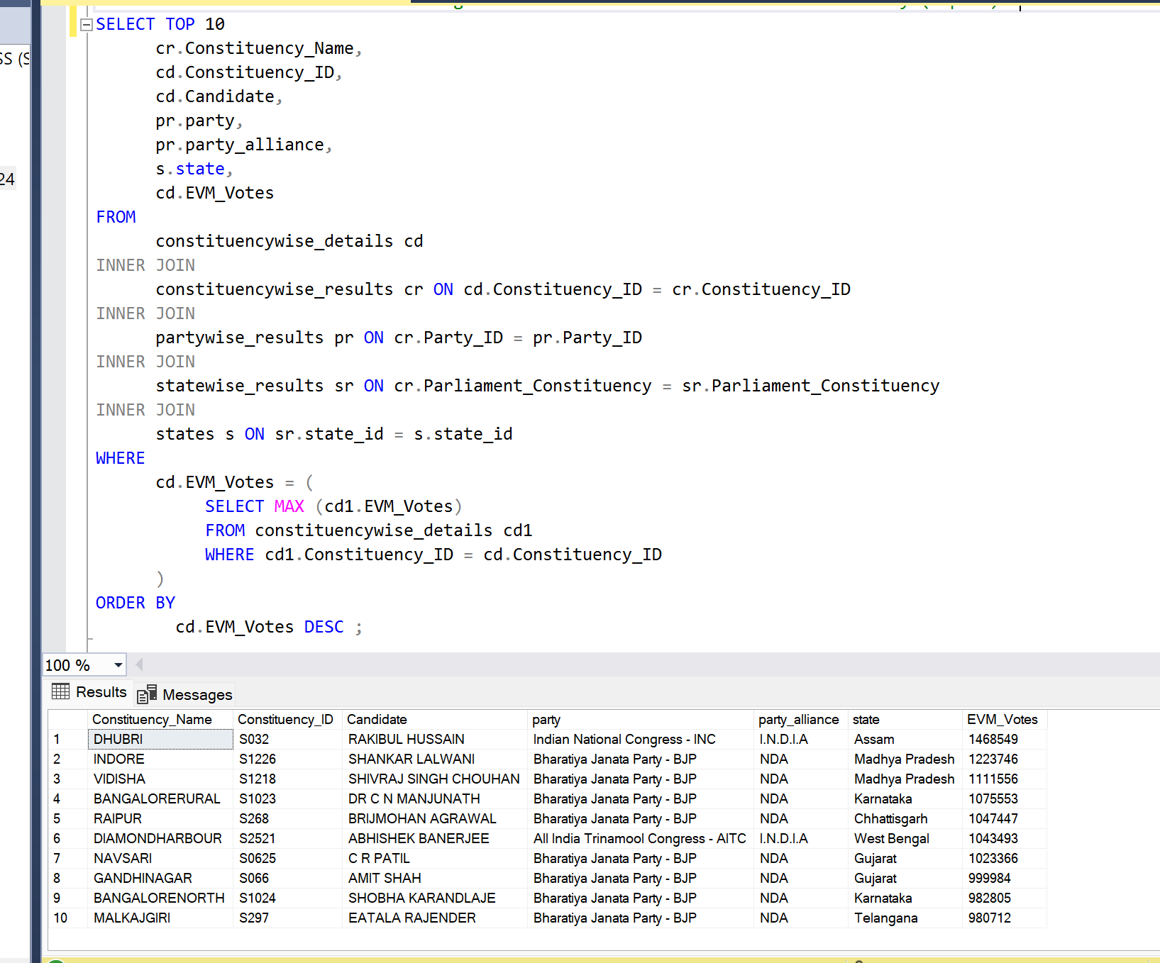
13.Which candidate received the highest number of EVM votes in each constituency (Top 10) ?

Slide 22
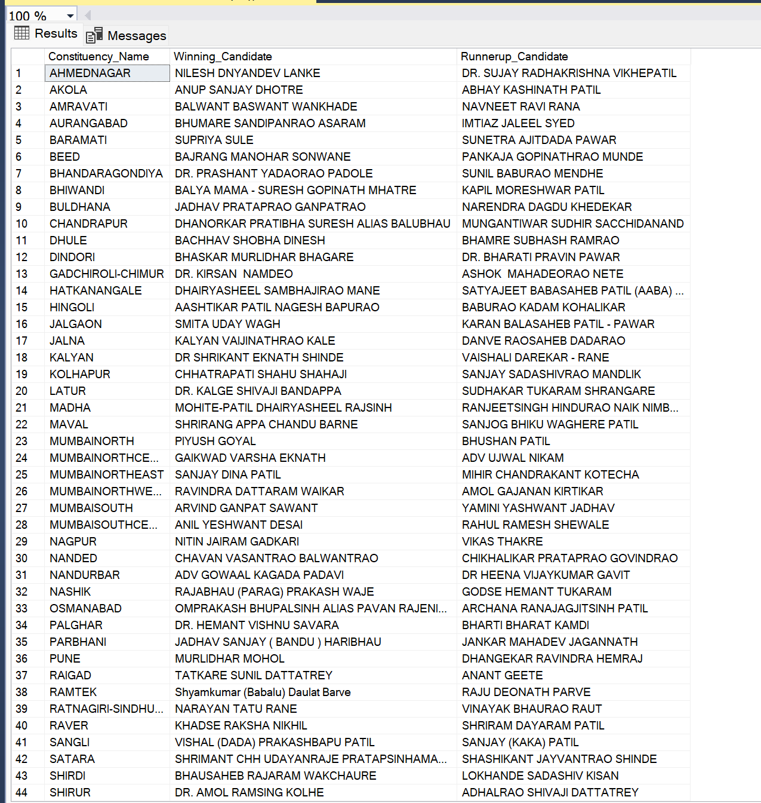
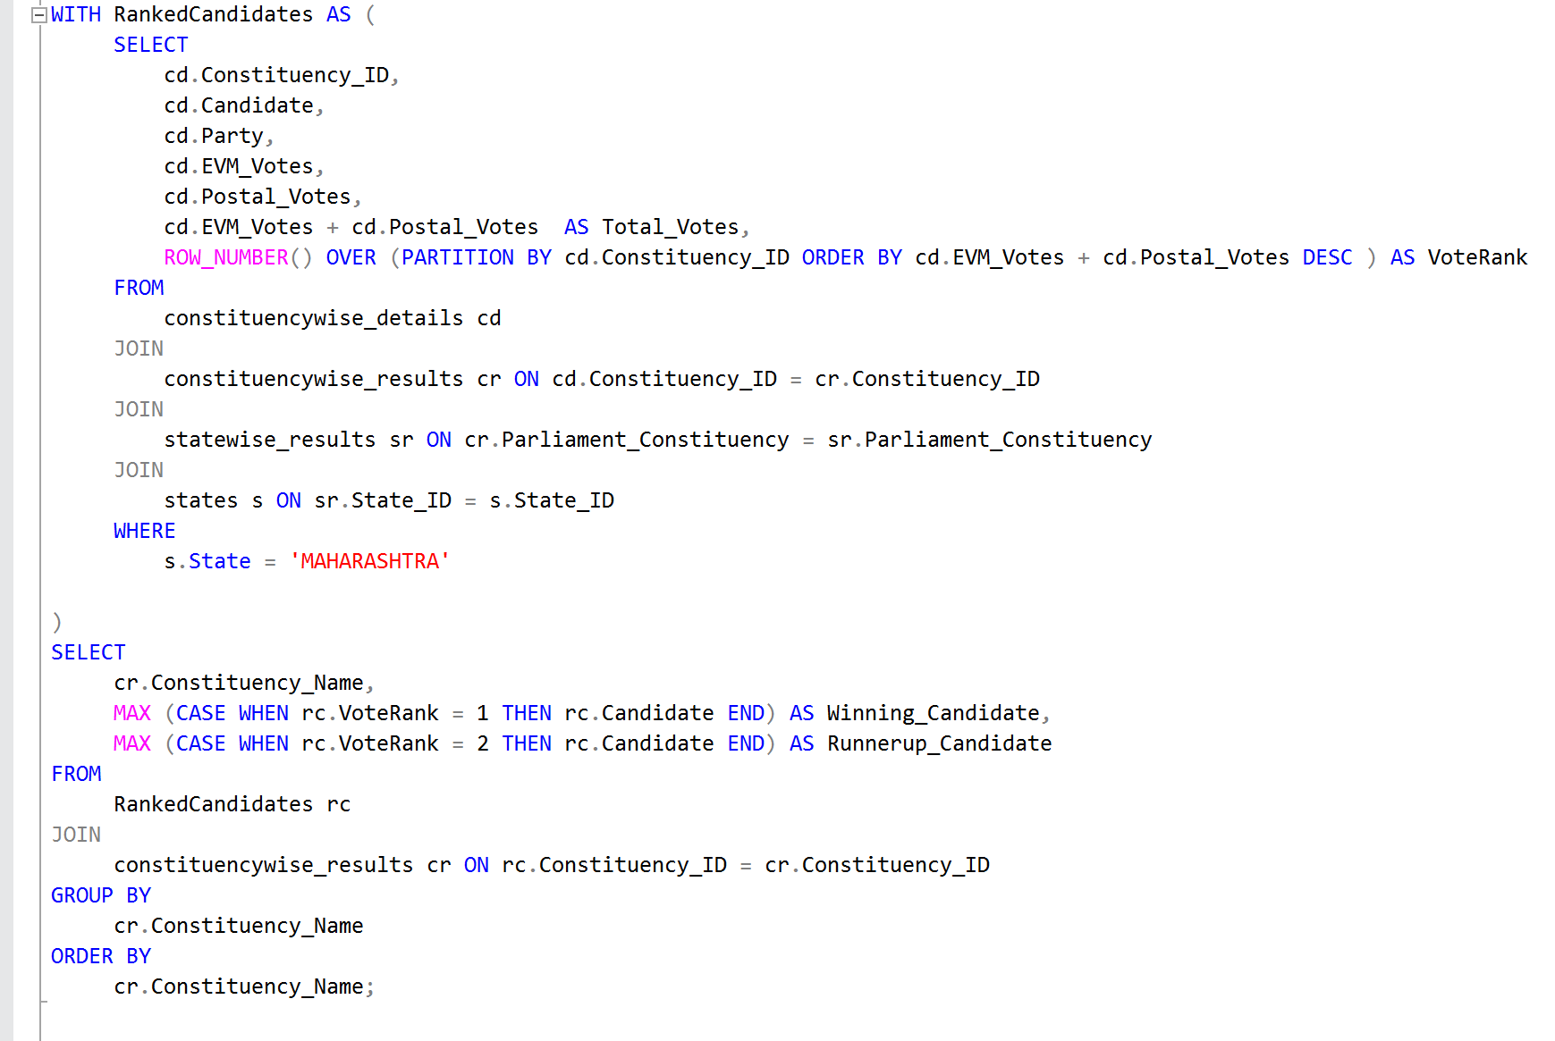
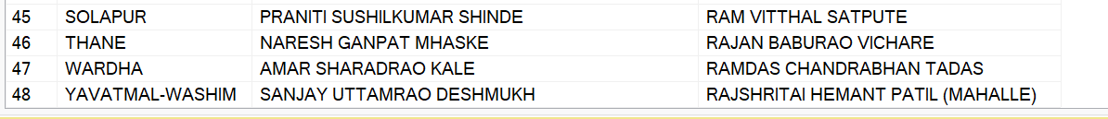
14.Which candidate won and which candidate was the runner-up in each constituency of state for the 2024 elections?

Slide 23
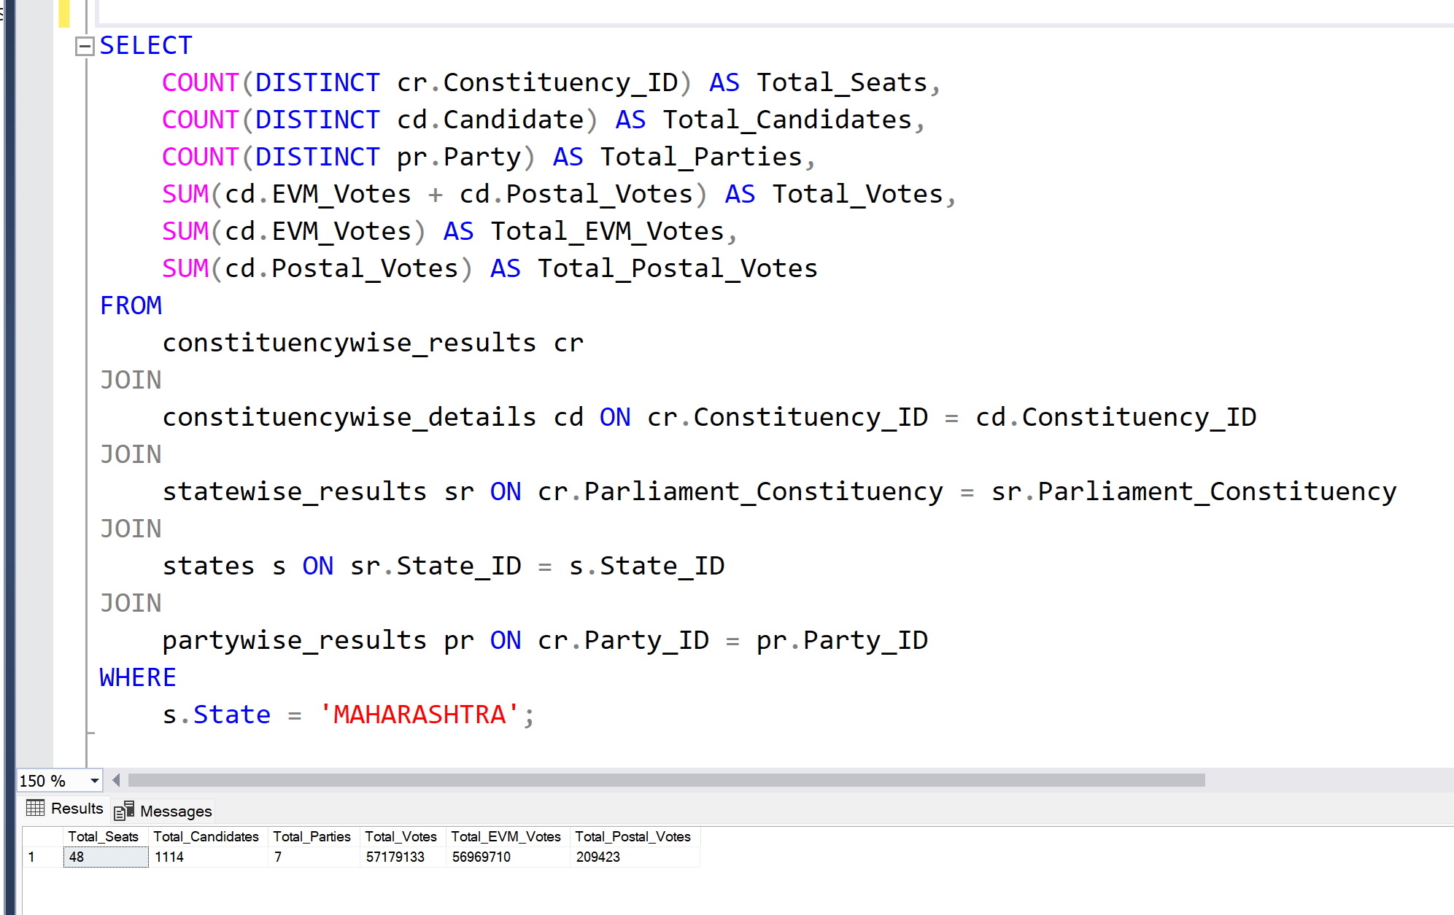
15.For the state of Maharashtra, what are the total number of seats, total number of candidates, total number of parties, total votes (including EVM and postal), and the breakdown of EVM and postal votes?

Slide 24
Functionalities Used
DISTINCT
COUNT
SUM
CASE
JOIN
ON
ORDER BY
GROUP BY
MAX()
ROW_NUMBER
SELECT
PARTITION BY
OVER()
WITH
UPDATE
ALTER TABLE
ADD
SET
WHERE
THEN
ELSE
HAVING
WINDOW
CTE
AVG()
RANK
DATE FUNCTIONS
INNER JOIN
LEFT JOIN
MULTI TABLE JOINS
SCHEMAS
IIF()
CAST()

Slide 25
PROJECT INSIGHTS
Bharatiya Janata Party – BJP has won the most seats ( 240 Seats) in all states in 2024.
The total seats won by NDA Alliance is 292,the total seats won by I.N.D.I.A Alliance is 234 and the OTHER won the 17 seats.
In Maharashtra Indian National Congress – INC won the most seats (13 seats).
The Indian National Congress got the highest number of EVM votes in Assam’s Dhubri constituency.

Slide 26
Thanks!!

